Slide 1
The Internet, the Web, and Electronic Commerce
2

Slide 2
Learning Objectives
Explain the origins of the Internet and the web.
Explain how to access the web using providers and browsers
Compare different web utilities including plug-ins, filters, file transfer utilities, and Internet security suites
Compare different Internet communications, including email, text messaging, instant messaging, social networking, blogs, microblogs, Webcasts, podcasts, and wikis

Slide 3
Learning Objectives continued
Describe search tools, including search engines and specialized search engines
Evaluate the accuracy of information presented on the web
Identify electronic commerce, including B2C, C2C, B2B, and security issues
Describe cloud computing, including the three-way interaction of clients, Internet, and service providers
Discuss the Internet of Things (IoT) and the continuing development of the Internet to allow everyday objects to send and receive data

Slide 4
Introduction
The Internet
Interconnected mesh of computers and data lines
Connecting millions of people and organizations
Foundation of the digital revolution.
The web
Provides an easy-to-use interface to Internet resources
To be effective and efficient
End user awareness of the resources available on the Internet and the web

Slide 5
The Internet and the Web
The Internet
Large global network connecting smaller networks all over the globe
The Internet launched in 1969
The United States funded a project to develop a national computer network
ARPANET (Advanced Research Project Agency Network)
World Wide Web or WWW was introduced in 1991
The Internet and the web are NOT the same
The Internet is the physical network
The web is a multimedia interface to the resources available on the Internet
Notes:
The Internet (key term) is the most developed network system currently in use; connects people all over the world
The Internet originally started in 1969 when US funded a research project (ARPANET—Advanced Research Project Agency Network) (key term)
World Wide Web (Web) is a part of the Internet – not the Internet; introduced in 1991 by consortium in Switzerland
Originally started as research and text-based network to exchange research ideas from university to university
Internet is the actual physical network comprised of wires, cables, satellites, and rules
Being connected to the network is often referred to as being online (Key Term)
The Web is a multimedia interface to resources available on the internet

Slide 6
Web
Web 1.0
1st generation
Linking existing information focus
Search programs were created
Provide links to websites with specific words or phrases
Web 2.0
Dynamic content creation
Facebook is most common in Web 2.0
Web 3.0
Current generation
Personalized content creation for users
Notes:
Web 1.0 (key term) – linking existing information
Web 2.0 (key term) – more dynamic content creation and social interaction (Facebook)
Web 3.0 (key term) – computer-generated information requiring less human interaction

Slide 7
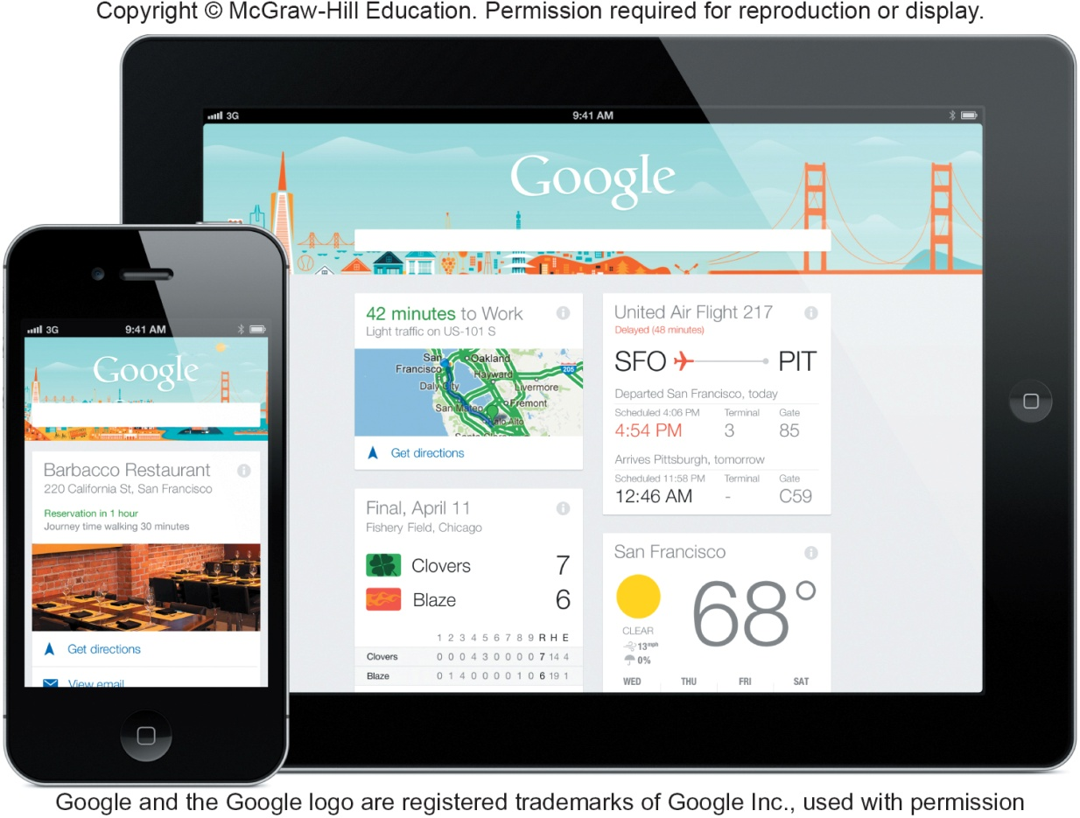
Common Internet Uses
Communicating
E-mail, photos, videos
Discussions
Shopping
Searching
Virtual libraries
Education or e-learning
Entertainment
Notes:
Most common Internet applications
Communicating – most popular Internet activity. Exchange e-mail, photos, videos
Shopping – fastest-growing applications
Searching - using virtual libraries.
Education or e-learning (Key Term) – take classes remotely from almost any location and any subject
Entertainment – music, movies, magazines, computer games
See the Making IT work for you for Online Entertainment (Page 30 – 31)

Slide 8
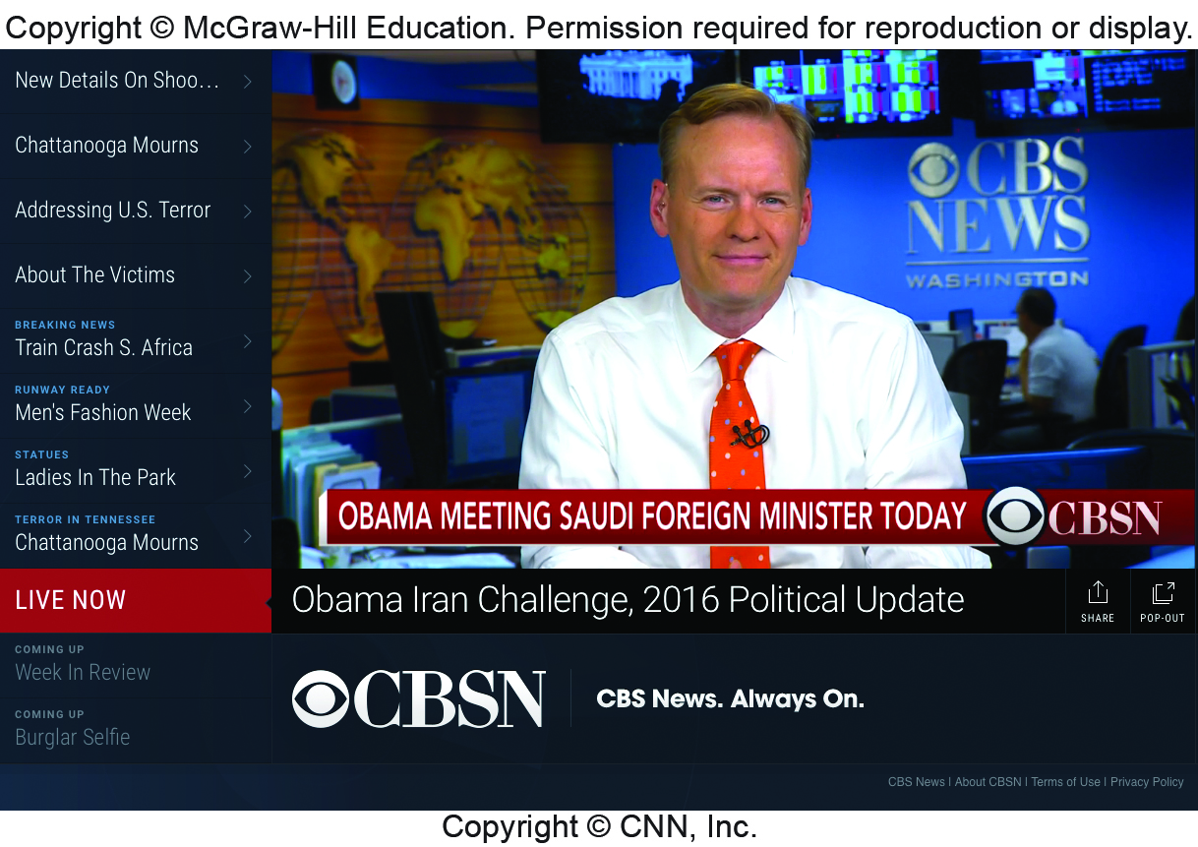

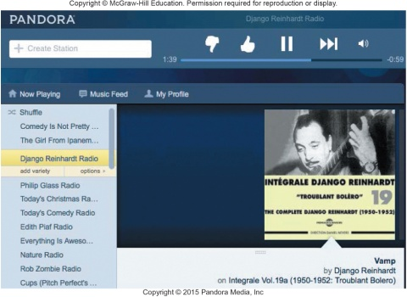
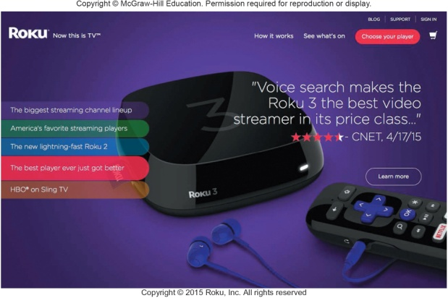
Making IT Work for You ~ Online Entertainment
Use the Internet to locate and play movies and television shows
Netflix, Hulu, Pandora
Notes:
Many users are no longer subscribing to cable or satellite services. Instead they are using pay-as-you-go services such as Netflix and Amazon Prime to watch movies and their favorite TV episodes.
Hulu Plus is used for TV Program
Pandora and Spotify for online music
And there is also Pay-as-you-go programs available

Slide 9
Internet Access Providers
Internet Service Provider (ISP)
Common way to access the Internet
Provide a path to access the Internet
Use telephone lines, cable, and/or wireless connections
Most common providers
Verizon, Comcast, Sprint, T-Mobile, AT&T
ISPS connect using connection technologies
DSL, Cable, Wireless
Notes:
The common way to access the Internet is through a provider or host computer
Internet Service Providers (ISPs) (key term) - already connected to the Internet -- furnish a pathway for other users
Most commonly used ISPs use telephone lines, cable (key term) and / or wireless connections
Typical providers include:
Verizon, Comcast, Sprint, T-Mobile and AT&T

Slide 10
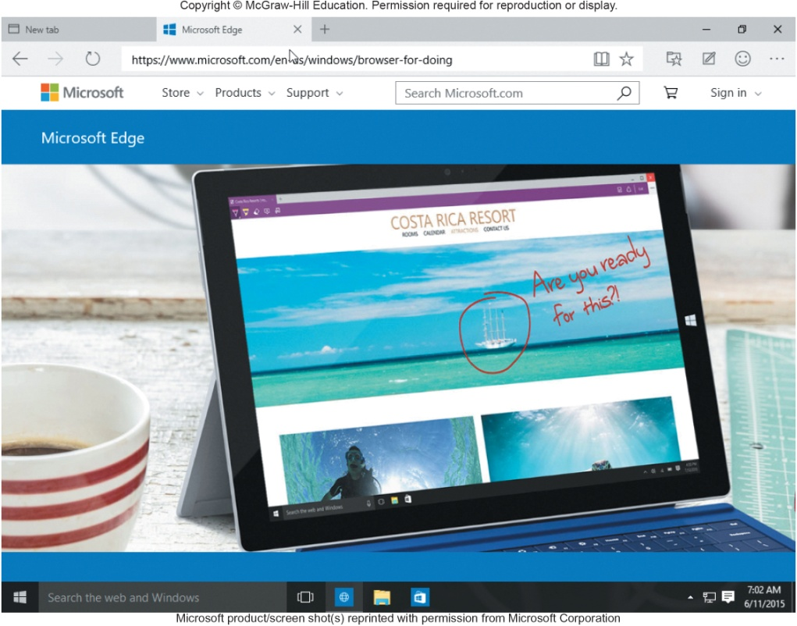
Browsers
Provide access to web resources
Allow you to explore the web
Uncomplicated interface to the Internet
Connect to remote computers
File transfer
Display many varieties of multimedia
Popular Web browsers include:
Mozilla Firefox
Apple Safari
Microsoft Edge
Google Chrome
Notes:
Browsers (key term) allow you to explore the web
Navigate, search for information and communicate using the web

Slide 11
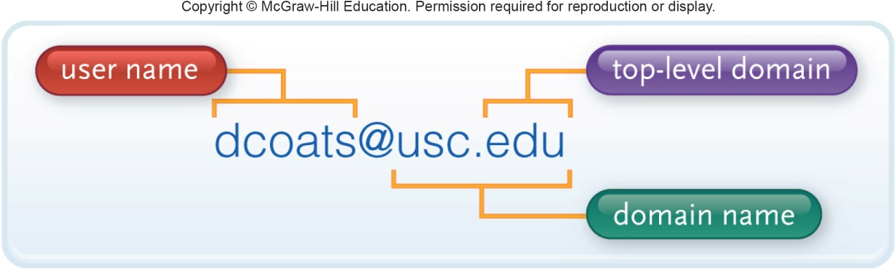
URLs
Uniform Resource Locator
Location or address of resource
https is the most common for web traffic
Two parts
Protocol
Rules for exchanging data
Domain name
Where resource is located
Notes:
Use URL (uniform resource locator) (Key Term) to connect to other resources. URL is the address (key term) and contains two parts.
Two parts to URL:
protocol (Key Term), rules for exchanging data between computers (usually http://);
domain name (Key Term) – specific address where the resource is located
Many URLs have additional parts specifying directory paths and file names.

Slide 12
Top-Level Doman (TLD)
Top-level domain (TLD) or Web Suffix
Identifies the type of organization
.com Commercial
.edu Educational
.gov Government
.mil U.S. military
.net Network
Notes:
TLD or Top-level domain (key term), also known as the web suffix identifies the type of organization

Slide 13
HTML and Hyperlinks
Hypertext Markup Language
Markup language for displaying web pages
Browsers interpret HTML commands
Display document as a web page
Hyperlinks or links
Connect to other web pages
Text files
Graphic images
Audio and Video Clips
Notes:
Browsers Interpret the HTML (key term) codes and formatting instructions and displays the page
May contain
Hyperlinks (Key Term) or links (key term) -- allow users to quickly connect to other pages or web sites
Graphics
Text
Multimedia elements

Slide 14
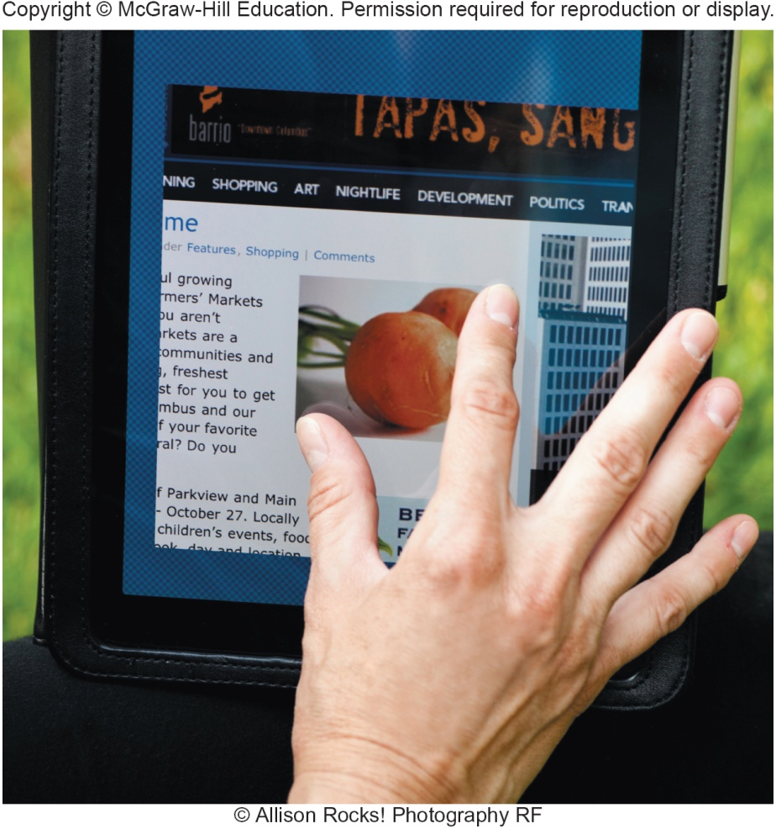
Interactive Web Sites
Technologies used to provide highly interactive and animated websites
Cascading Style Sheets (CSS)
JavaScript
AJAX
Applets
Mobile Browsers
Designed to run on portable devices
Notes:
Cascading Style Sheets (key term) – files referenced that control the appearance of a web page giving them consistent look for presentation.
JavaScript (key term) – language used with HTML documents to trigger interactive features such as opening a new browser
AJAX (key term) – (Asynchronous Java Script and XML) JavaScript used to create interactive websites that respond quickly.
Applets (key term) – used to present animation, display graphics, provide interactive games
Mobile Browsers (key term) – designed to run on portable devices. Contain special navigational tools for convenience to pinch and stretch

Slide 15
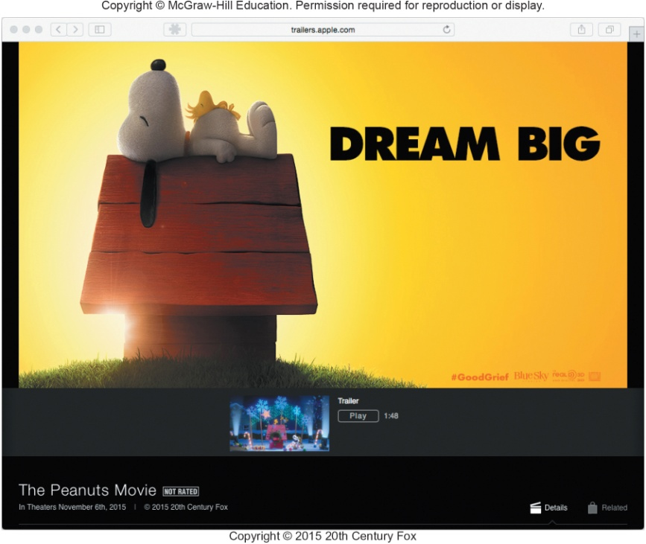
Web Utilities
Specialized utility programs that make using the Internet and web safer and easier
Plug-Ins
Filters
File Transfer Utilities
Internet Security Suites
Notes:
Web utilities (key term) are specialized utility programs that make using the Internet and web easier and safer
The utilities we will discuss are:
Plug-ins – The graphic on this slide is from Apple. It is QuickTime for playing audio and video files.
Filters
File Transfer Utilities
Internet Security Suites

Slide 16
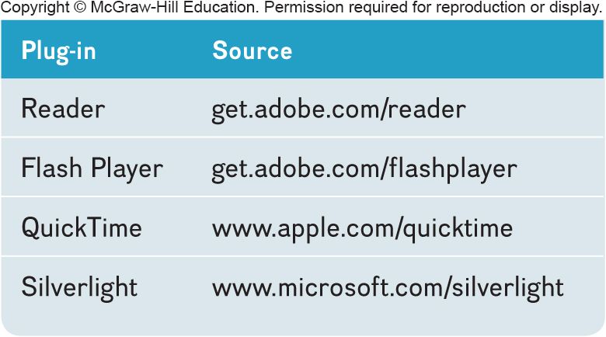
Plug-Ins
Automatically start and operate as part of you browser
Enhanced browsing experience
enables special file formats and multimedia elements
Acrobat Reader
Flash Player
QuickTime
Windows Media Player
Notes:
Plug-ins (key term) – programs that start automatically and operate as part of your Browser
Adobe Reader from Adobe – pdf – viewing and printing a variety of standard forms and other documents
Flash Player from Adobe – viewing videos, animations and other media
QuickTime from Apple – playing audio and video files
Windows Media Player – playing audio files, video files and much more

Slide 17
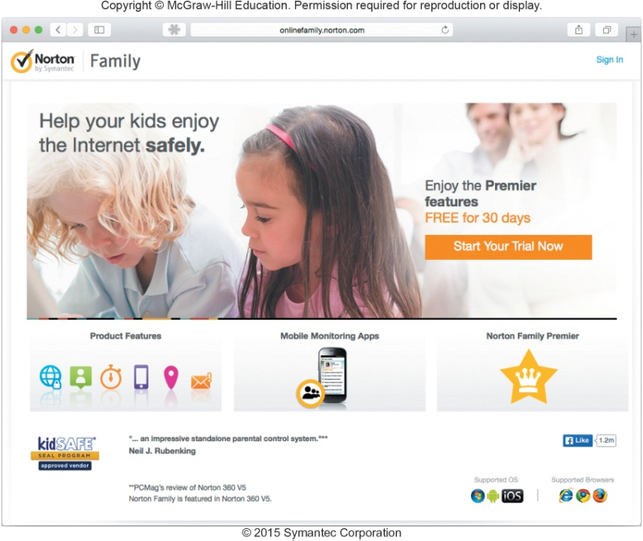
Filters
Block access to selected sites and can set time limits
Monitor total time spent on the Internet and at individual web sites
AVG Family Safety
Qustodio Parental Control
Norton Online Family
Net Nanny
McAfee Family Protection
Notes:
Filters (key term) – block access to selected sites.
Filters can also monitor use and generate reports detailing the total time spent on the Internet and specific sites.
Best know filters
AVG Family Safety
Qustodio Parental Control
McAfee Family Protection

Slide 18
File Transfer Utilities
Upload and download files to and from the Internet
Downloading
Uploading
Three popular types of programs
File transfer protocol (FTP) / Secure file transfer protocol (SFTP)
Web-based file transfer services
Bit-Torrent
Notes:
Also referred to as downloading (key term) – receiving a file from the Internet and uploading (key term) copying a file to the Internet
File Transfer Protocol (key term) and Secure File Transfer Protocol (key term) (FTP & SFTP)
copy files from your computer to the internet
used for uploading changes to a website
Web-based file transfer services (key term)
uses web browser to upload and download files
Dropbox.com is a widely used service
BitTorrent (key term)
distributes file transfers across many computers for more efficient downloads
good for transferring large files

Slide 19
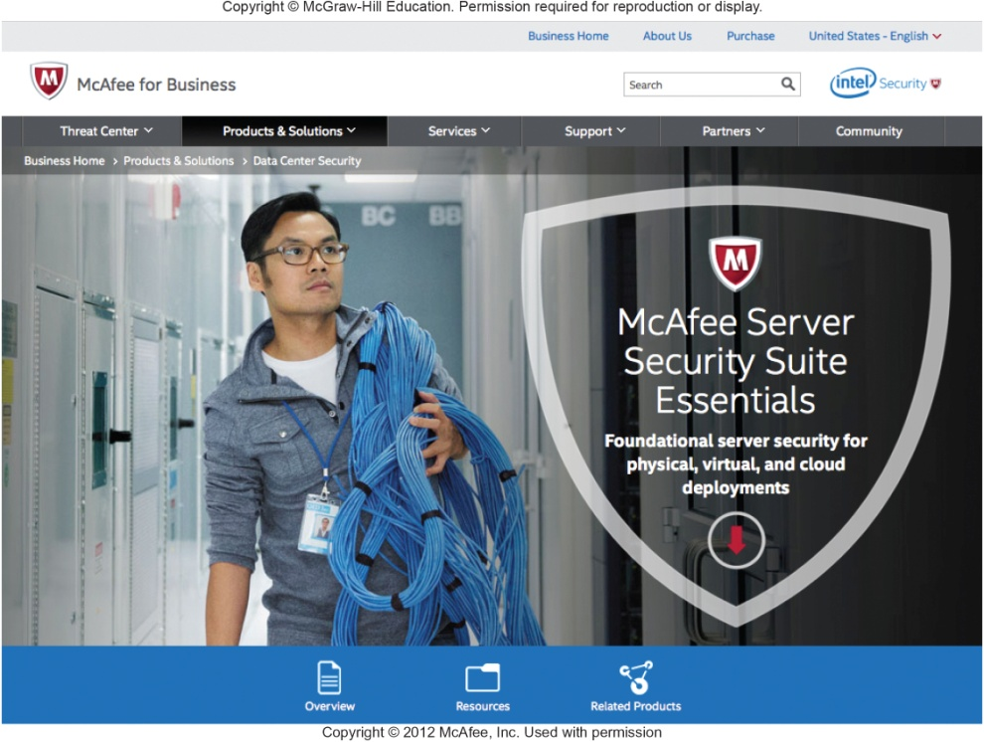
Internet Security Suites
Designed to maintain your security and privacy while on the web
Two best known suites
McAfee Internet Security
Symantec Norton Internet Security
Notes:
Internet Security Suites (Key Term) – collection of utility programs designed to maintain your security and privacy while you are on the Web
Suites Are the most cost efficient way to go instead of buying each component separately.
McAfee Internet Security
Symantec Norton Internet Security

Slide 20
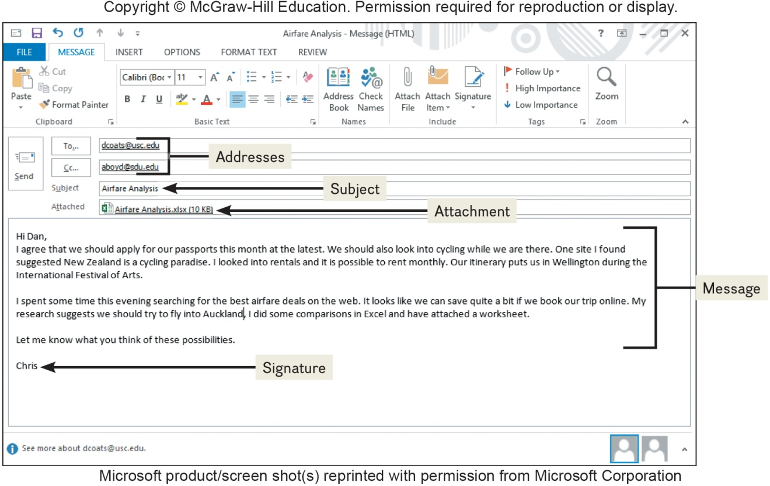

Communication
Communication is the most popular Internet activity
E-mail
Transmission of electronic messages over the Internet
Three elements
Header
Address
Subject
Attachments
Message
Signature
Notes:
Communication – most popular Internet activity: e-mail, messaging, social networking, blogs, microblogs, webcasts, podcasts, and wikis
E-mail or electronic mail (Key Term)
Transmission of electronic messages over the Internet
Has three basic elements: header (key term), message and signature
Header contains:
Address (key term) – who the e-mail is going to.
Address (Key Term) has two parts
User name - identifies unique user or computer in the domain
Domain name (Key Term) - references a specific organization
Subject (key term) – topic of the message
Attachments: (key term) – documents and / or images you attach to the message
Message: (key term) – letter
Signature: (key term) – information about the sender

Slide 21
E-mail Systems
Client-based
E-mail client
Must be installed on computer
Apple Mail
Microsoft Outlook
Web-based
Webmail client
No installation necessary -- free
Google’s Gmail
Microsoft’s Hotmail
Yahoo!’s Yahoo!mail
Notes:
Client-based e-mail system (key term) – requires installation of an e-mail client (key term) on your computer. Examples are Microsoft Outlook and Apple Mail.
Web-based e-mail system (key term) – no email program on your computer, access from any computer through a Browser. Examples are Google Gmail, Microsoft Hotmail, Yahoo!Mail

Slide 22
E-mail
SPAM
Unwelcome-mail
Computer viruses
Destructive programs
Attached to unsolicited email
CAN-SPAM Act
Created antispam laws for control
Every marketing related e-mail must provide an opt-out option
Spam blockers / spam filters
Identify and control spam
Free programs
SPAMfighter
Intego Personal Antispam for Mac
Notes:
Spam (Key Term) – unsolicited / unwelcome e-mail
Distraction, Nuisance
Computer viruses (Key Term) can also be attached to spam
Spam blockers (Key Term)/ Spam filters (key term) use a variety of different approaches to identify and eliminate spam
CAN-SPAM Act requires that every marketing related email provide an opt-out option
Tips to blocking spam:
Keep a low profile
Don’t ever respond to spam and be cautious when giving out your address
Use e-mail filter options
Use antispam and filter options

Slide 23
Messaging
Text messaging / texting
SMS (short message service)
Short electronic message
Multimedia Messaging Service (MMS)
Send
Images
Videos
Sounds
Notes:
Text Messaging (key term) – also know as texting (key term) is sending short electronic messages between mobile devices.
SMS (short Message Service (key term)
Has become one of the most widely used ways to send short messages
Many states have passed laws prohibiting texting while driving due to the negative impact on driver safety according to a study conducted by Car and Driver
Multimedia Messaging Service (MMS)
Enables users to not only send text but also images, videos, and sounds

Slide 24
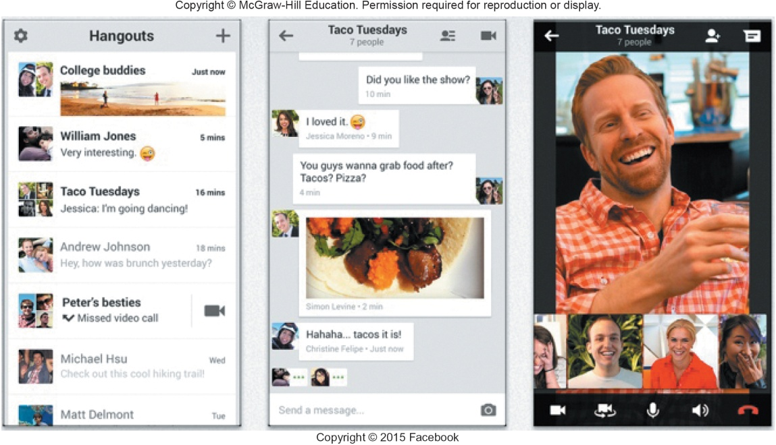
Instant Messaging
Instant messaging
Extension of email that provides direct, live communication between two or more people
Most programs include video conferencing features, file sharing and remote assistance
Facebook Messenger
Google Hangouts
Notes:
Instant Messaging (Key Term)
Extension of email that allows two or more people to contact each other via direct, live communication
To use instant message, specify list of friends (Key Term) and register with an instant messaging server
Some services include video and file-sharing

Slide 25
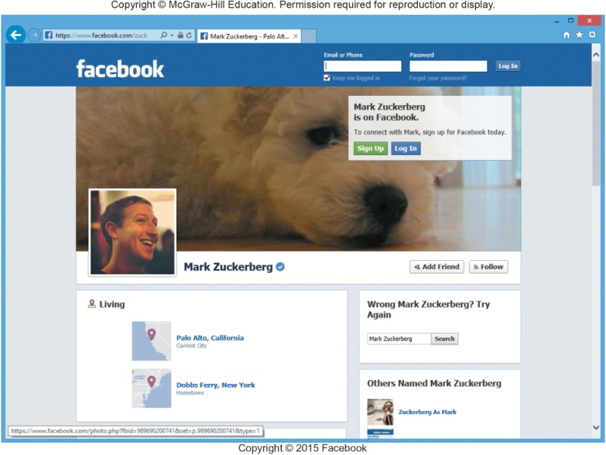
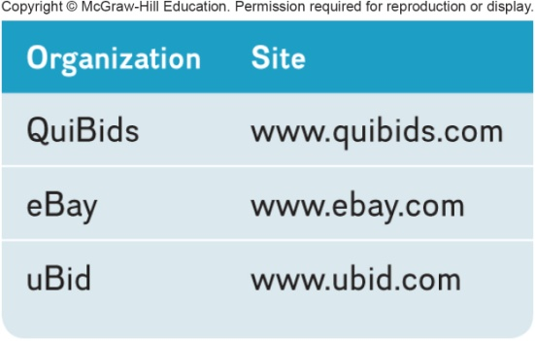
Social Networking
Connecting people and organizations that share a common interest or activity
Three most popular:
Facebook
Facebook Profiles
Facebook Pages
Facebook groups
Google+
Circles
Hangouts
LinkedIn
Business-oriented
Notes:
Social Networking (Key Term)
One of the fastest growing uses of the Internet
Connecting individuals to one another
Facebook (Key term)– individuals, businesses, communities – launched in 2004
Facebook – instant messaging, photo, video sharing, games, etc.
Facebook Profiles (key term) – personal information. Available to friends, family
Facebook Pages (key term)– created by businesses and public figures
Facebook Groups (key term)– created by individuals who share a common interest
Google+ (key term) or Google Plus (key term) – includes circles (key term) for grouping individuals according to common interests – launched in 2011
Hangouts (key term) – to communicate with up to 10 people at one time
LinkedIN (key term) – Business/professionally oriented social networking -- launched in 2003
Consider carefully the information you are disclosing when joining social networking sites.

Slide 26
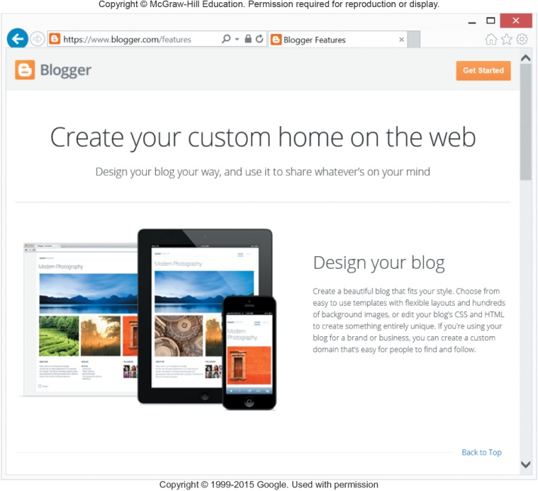
Blogs, Microblogs
Web logs or blogs
Personal news pages
Date/time-stamped
Arranged with the most recent items shown first
Microblogs
Short status updates
Most common is Twitter
Tweets are Twitter messages
Notes:
Popular web logs (key term) or blogs (key term) include Blogger and WordPress
Twitter (key term) is the most popular microblog (key term)

Slide 27
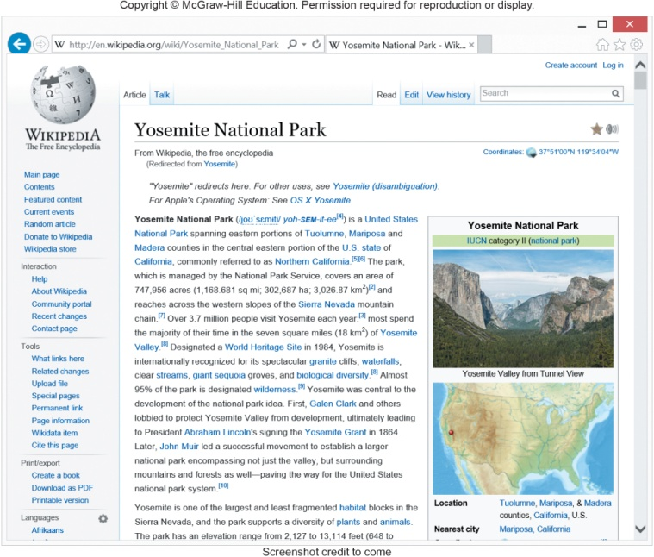
Webcasts, Podcasts, Wikis
Webcast
Streaming technology for live broadcast of audio and video
No files after streaming ends
Podcast
Must download files to use
Can transfer to media player
Wiki
Specially designed Web site
Allows visitors to edit the contents
Supports collaborative writing
Notes:
Webcasts (key term) streaming technology (key term) using audio and video continuously downloaded to your computer
YouTube is a popular example
After webcast is complete, no files remain on your computer
Podcasts (key term) available on iTunes and do not use streaming technology
Wiki (key term) – website which is editable by users. Built on a community of interested people that build knowledge over time.
Wikipedia (key term) is an example of using a wiki as an online encyclopedia

Slide 28
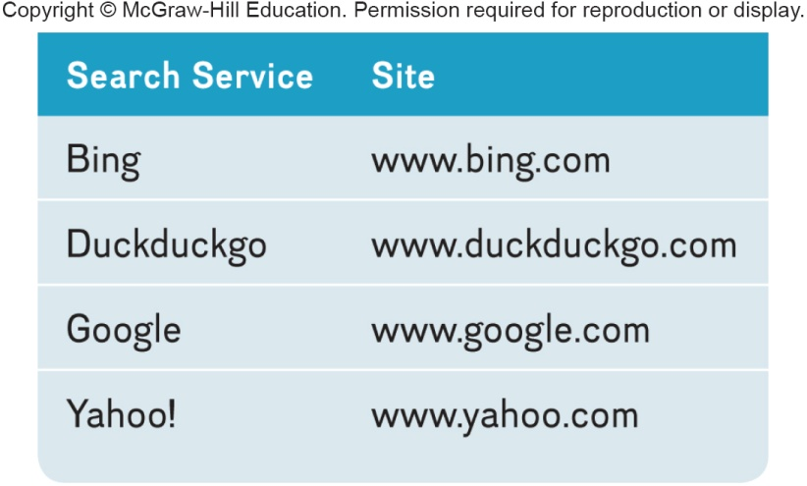
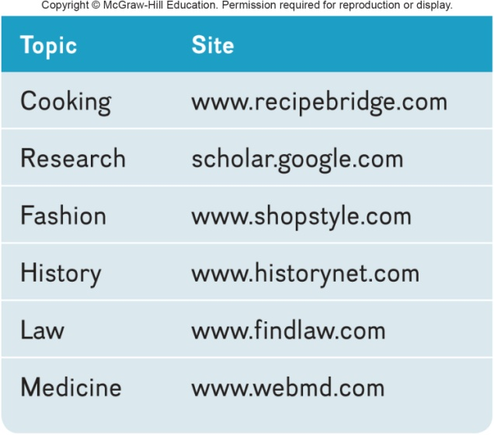
Search Tools
Search Services
Operate websites
Spiders
Look for new information and update websites
Search Engines
Assist in locating specific information
Specialized Search Engines
Focus on subject specific websites
Notes:
Specialized programs that assist you in locating information on the Web and the Internet
Search services (Key Term) operate web sites that help you locate information; they maintain the database that helps you get where you want
Special programs called spiders (Key Term) continually look for information and updated services
Search engines (Key Term) – assist you to locate specific information
Use keyword or phrase search; know “rules” i.e. use + or quotes to look for phrases rather than individual words
Hit (key term) – return of sites that contain keyword or phrases
Specialized search engines (Key Term) - Programs that focus on subject specific Web sites

Slide 29
Content Evaluation
Content Evaluation
Not everything on the Internet is accurate
Authority
Accuracy
Objectivity
Currency
Notes:
Content Evaluation – be sure to check the authority, accuracy, objectivity and currency

Slide 30
Electronic Commerce
E-commerce
Buying and selling of goods over the Internet
Three basic types
Business-to-consumer (B2C)
Consumer-to consumer (C2C)
Business-to-business (B2B)
Notes:
Electronic commerce (key term) or E-Commerce (key term) is buying and selling over the Internet
Three basic types of electronic commerce: business to consumer; consumer to consumer; and business to business
B2C
C2C
B2B

Slide 31
Business to Consumer (B2C)
Sale of product or service to general public
Fastest growing type of e-commerce
Three most widely used B2C applications:
Online banking
Financial trading
Shopping
Amazon.com is one of the most widely use B2C sites
Notes:
B2C (key term) is fastest growing type of e-commerce. Involves the sale of a product or service to the general public or end user.
Three types
Online banking
Financial trading
Shopping
Amazon.com is one of the most widely used B2C sites.

Slide 32

Consumer to Consumer C2C
Consumer-to-consumer e-commerce (C2C)
Individual to individual
Web auctions
Buyers and sellers seldom meet
Bids are submitted electronically
Person-to-person auction sites
Notes:
Recent trend in C2C e-commerce (key term) involves individuals selling to individuals and is Web auctions (Key Term); similar to traditional auctions – no one sees each other
Buyers and sellers seldom meet face-to-face
Ask the students if they have ever used E-bay
Example auction sites include eBay, QuiBids, eBay, eBid.

Slide 33
Business to Business B2B
Sale of a product or service from one business to another
Primarily a manufacturer supplier relationship
Notes:
Business to Business (B2B) (key term) involves the sale of a product or service from one business to another.
Example: A furniture manufacturer requires raw materials such as wood, paint, and varnish.

Slide 34
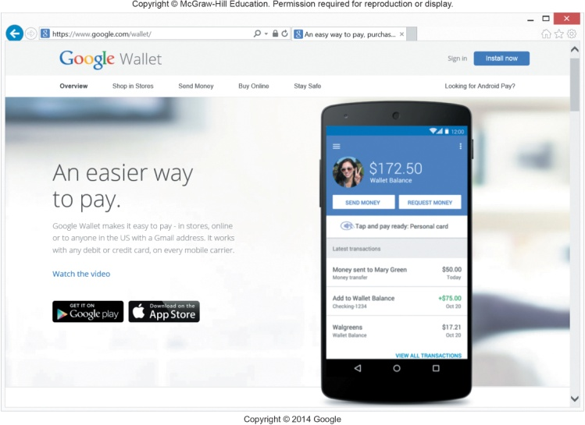
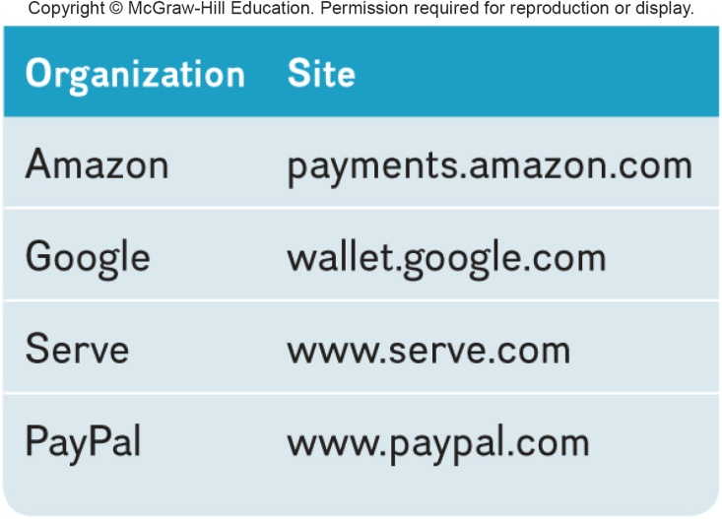
Security
Payment methods must be fast, reliable, and secure
Provide a convenient way to submit buyers information
Two options
Credit card
Fast and convenient
Digital cash
Internet’s equivalent to traditional cash
Converts digital cash to currency through 3rd party
Notes:
A challenge is the payment for goods
Should be reliable, secure, and fast
Convenience
Electronic payment -- easy, secure payment method
Credit cards -- easier to work with, somewhat vulnerable to theft
Digital cash (Key Term)
Purchased from third party (usually a special bank); more secure than credit cards
Providers include Amazon, Google, Serve, and PayPal

Slide 35
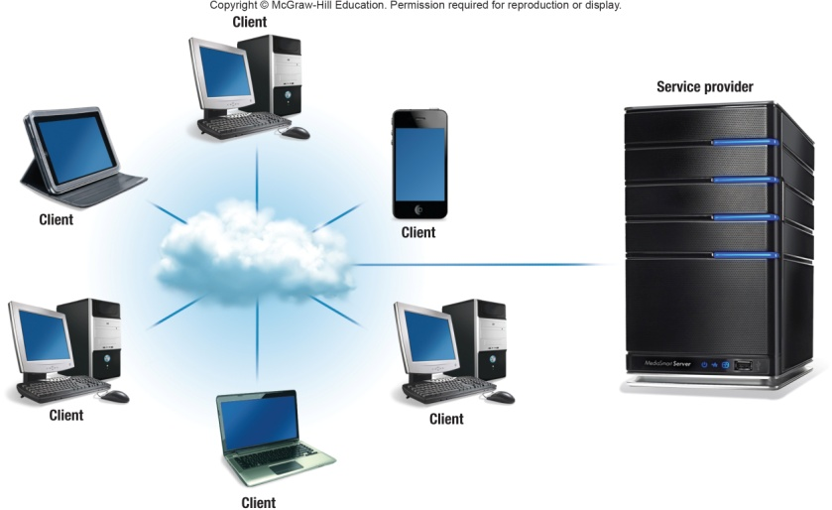
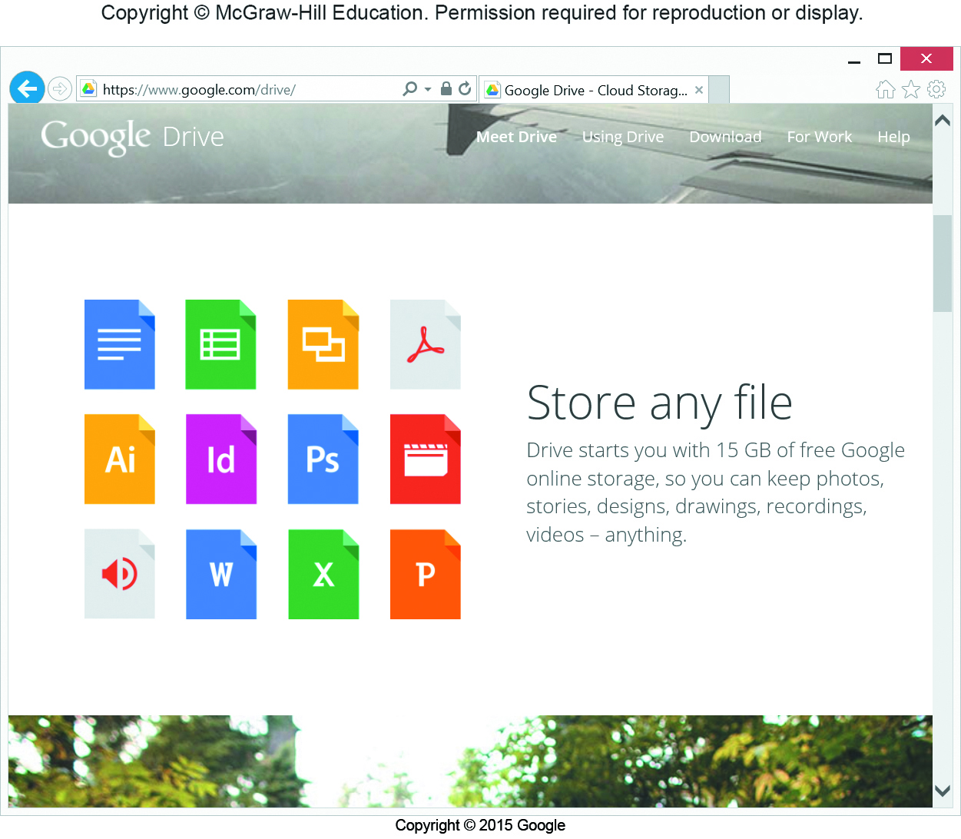
Cloud Computing
Shifts computing activities from users’ computers to computers on the Internet
Frees end-users from owning, maintaining, and storing software programs and data
Three basic components:
Clients (end-users)
Service providers
The Internet
Notes:
Cloud computer (key term) Basic components include:
Clients: corporations and end-users who want access to data, programs, and storage anywhere and anytime a connection to the Internet is available
Service providers: organizations that are willing to provide (sometimes for a fee) access to software and storage
Internet connectivity
Two critical factors that determine the efficiency of cloud computing
The speed and reliability of the user’s access to the Internet
Internet’s capability to provide safe and reliable transmission of data and programs

Slide 36
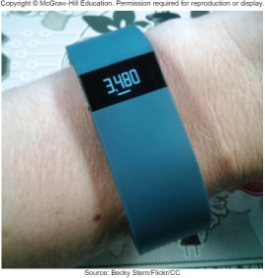
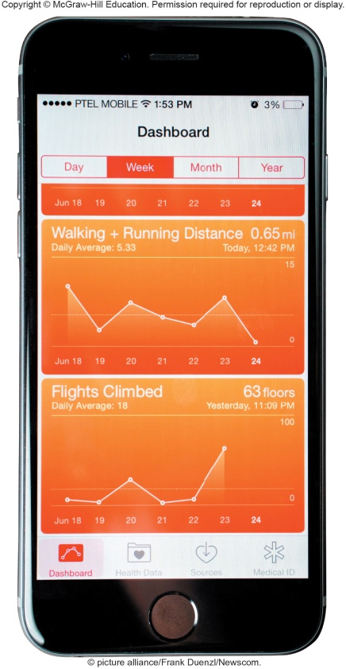
Internet of Things (IoT)
Continuing development of the Internet
Allows objects embedded with electronic devices to send and receive data
Smartphones
Wearable devices
Uses Web 3.0 Applications
Notes:
Internet of Things (IoT)
Continuing development of the Internet which allows objects embedded with electronic devices to send and receive data
Includes
Smartphones
Wearables
Uses web 3.0 applications to sync devices with web applications

Slide 37

Careers In IT - Webmasters
Develop and maintain websites and resources
Backup of company website
Design and development of websites
Work with the marketing
Increase site traffic
Development of web promotions
Notes:
Webmasters
Employers look for:
Bachelor’s or associate’s degree in computer science or information systems
Knowledge of common programming
Web development software knowledge
HTML and CSS are important
Web Authoring knowledge
Good communication and organizational skills are essential
Salary in the range of $59,000 to $82,000

Slide 38
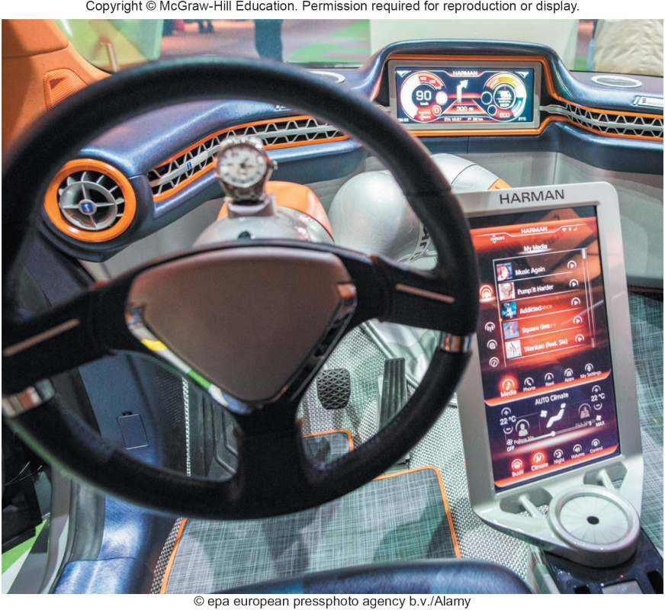
A Look to the Future
Car’s Dashboard as a power, Internet-connected computing device
Safety and diagnostic features are already there
Potential distractions?
Notes:
Your car today is already governed by computer technology located within your vehicle.
Benefits involve quick access to vital information such as traffic, weather, directions in real time.
Potential distractions could also come into play. Technology would need to be cautious and prevent the driver from ever having to touch the dashboard by using voice recognition.

Slide 39
Open-Ended Questions (Page 1 of 3)
Discuss the Internet, including their origins, the three generations of the web, and the most common uses.
Describe how to access the Internet. What are the providers? Define browsers and discuss URLs, HTML, CSS, JavaScript, AJAX, applets, and mobile browsers.
What are Web utilities? Discuss plug-ins, filters, file transfer utilities, and Internet security suites
Notes:
Have students turn to the end of Chapter 2 in their textbooks to view the same “Open-Ended” questions/statements

Slide 40
Open-Ended Questions (Page 2 of 3)
Discuss Internet communications, including client-based and web-based email, instant and text messaging, social networking, blogs, microblogs, webcasts, podcasts, and wikis.
Define search tools including search services. Discuss search engines and specialized search engines. Describe how to evaluate the content of a web site.
Notes:
Have students turn to the end of Chapter 2 in their textbooks to view the same “Open-Ended” questions/statements

Slide 41
Open-Ended Questions (Page 3 of 3)
Describe electronic commerce, including business-to-consumer, consumer-to-consumer, and business-to-business e-commerce, and security.
Discuss the Internet of Things. Describe how Fitbit and Apple’s Health App are examples of how an IoT device can interact with a Web 3.0 application.
What is cloud computing? Describe the three basic components of cloud computing.

